Slide 1
Random Forest Regression
Akhilesh Joshi

Slide 2
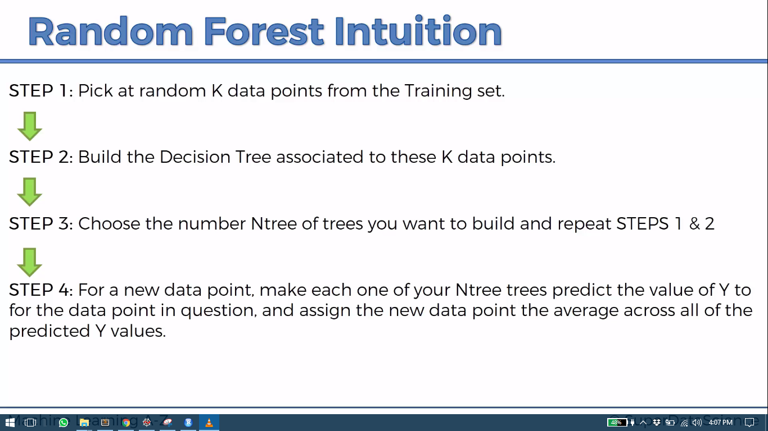

Slide 3

Python

Slide 4
Reading file dynamically
from tkinter import *
from tkinter.filedialog import askopenfilename
root = Tk()
root.withdraw()
root.update()
file_path = askopenfilename()
root.destroy()

Slide 5
Importing Libraries
import pandas as pd
import numpy as np
import matplotlib.pyplot as plt

Slide 6
Importing dataset
dataset = pd.read_csv(file_path)
X= dataset.iloc[:,1:2].values
y= dataset.iloc[:,2:3].values

Slide 7
Random forest Treez Regressor
from sklearn.ensemble import RandomForestRegressor
regressor = RandomForestRegressor(n_estimators=100, random_state = 0)
model = regressor.fit(X,y)

Slide 8
Prediction
model.predict(6.5)

Slide 9
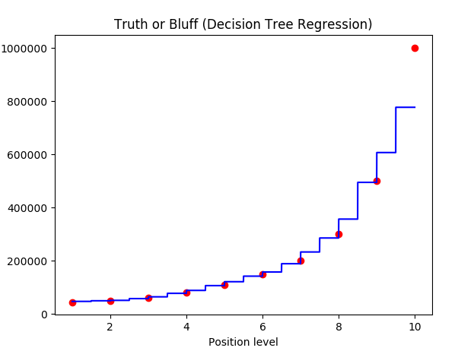
Plot
X_grid = np.arange(min(X), max(X), 0.001)
X_grid = X_grid.reshape((len(X_grid), 1))
plt.scatter(X, y, color = 'red')
plt.plot(X_grid, regressor.predict(X_grid), color = 'blue')
plt.title('Truth or Bluff (Decision Tree Regression)')
plt.xlabel('Position level')
plt.ylabel('Salary')
plt.show()
Note : as number of trees increases you don’t see much of increase in steps as more trees start converging to same average

Slide 10

R

Slide 11
Read dataset
library(readr)
dataset <- read_csv("D:/machine learning AZ/Machine Learning A-Z Template Folder/Part 2 - Regression/Section 7 - Support Vector Regression (SVR)/SVR/Position_Salaries.csv")
dataset= dataset[2:3]

Slide 12
Library Required - randomForest
library('randomForest’)
set.seed(1234)
regressor = ra
NOTE:
#dataset[1] : gives dataframe
#dataset$Salary : gives a vector since we require vectore for y ndomForest(x= dataset[1] , y= dataset$Salary, ntree=1000)

Slide 13
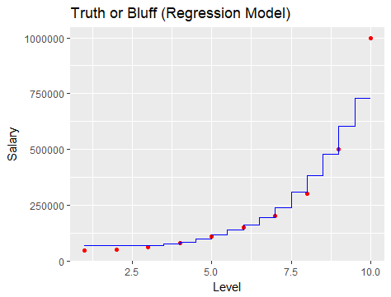
PLOT
# install.packages('ggplot2')
library(ggplot2)
x_grid = seq(min(dataset$Level), max(dataset$Level), 0.001)
ggplot() +
geom_point(aes(x = dataset$Level, y = dataset$Salary),
colour = 'red') +
geom_line(aes(x = x_grid, y = predict(regressor, newdata = data.frame(Level = x_grid))),
colour = 'blue') +
ggtitle('Truth or Bluff (Regression Model)') +
xlab('Level') +
ylab('Salary')

Slide 14
prediction
prediction = predict(regressor,data.frame(Level=6.5))

